Slide 1
Predicting NBA MVP
With Lasso Regression
Han Li

Slide 2
Table of Contents
Project Intro
Modeling
Dataset Processing
Model Analysis
Conclusion & Reflection
Graphing & Selecting Features
Notes:
Project Intro
Dataset cleaning
Graphing / selecting variable
Data processing
Why lasso
Model evaluation
Conclusion

Slide 3
Project Intro
Purpose, Scope, and Summary

Slide 4
Project Introduction
Purpose:
Create model that learns from data of previous season MVPs
Predicts the current season’s MVP based on current player data
Scope:
Use data from 2000-2022:
Previous advanced statistics not recorded
Different criteria for MVP
>10,000 players, >25 potential features

Slide 5
Datasets
Dataset Selection, Cleaning, Processing

Slide 6
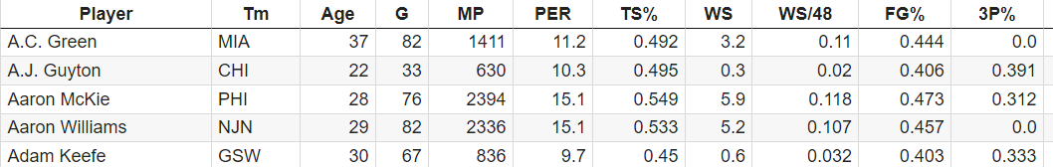
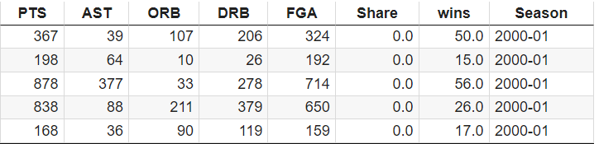
Basketball Reference
General Player Stats:
Regular game statistics
GP, MP, Pts, Ast, FG%, etc
Advanced Player Stats:
Advanced game statistics
WS, PER, TS%

Slide 7
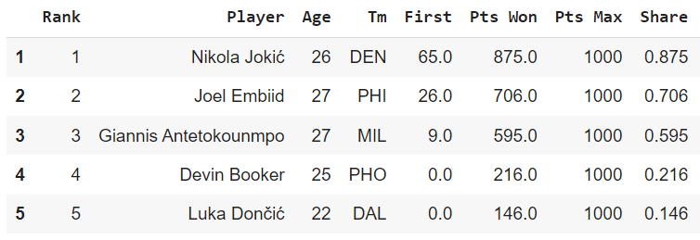
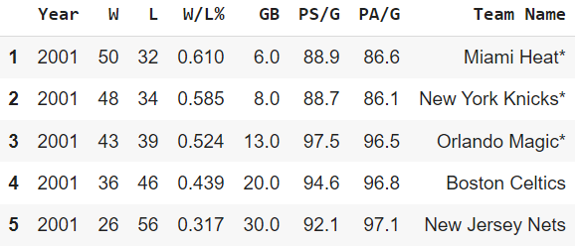
Basketball Reference
MVP Stats:
Top MVP candidates
MVP voting shares
Team Stats:
Stats for every team in the NBA
W/L% for each team

Slide 8
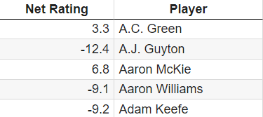
Kaggle
Advanced Player Statistics:
Stats for every team in the NBA
PER for each player

Slide 9
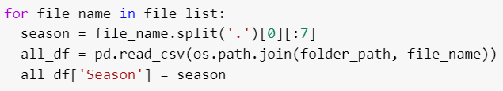
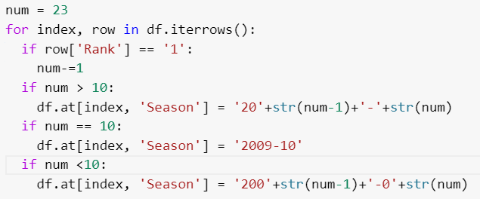
Cleaning/Processing
Added season/year columns to all dataframes
Regular/advanced stats: File names indicate year
MVP shares: New season every rank “1”
NBA teams: N/A
PER: N/A
Notes:
Removed duplicate players for each season
Combined advanced stat and regular stat into one dataframe

Slide 10

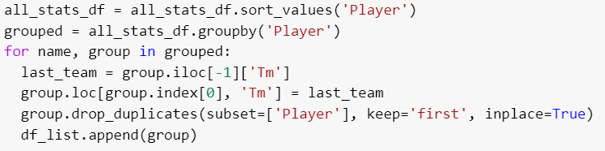
Cleaning/Processing
Removed duplicate players
Some players showed up multiple times per season
Placed in consecutive order
Assign last consecutive player’s team to first consecutive player’s team
Drop others
Combined regular and advanced statistic dataframes!

Slide 11
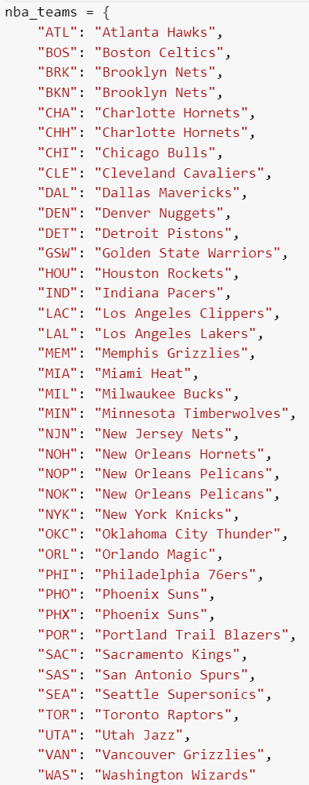
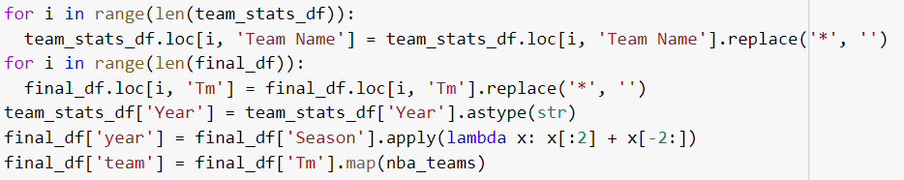
Cleaning/Processing
Merge team win, MVP share, and PER dataframe with previous combined dataframe
Remove “*” in team name columns
Change “season” to be compatible with “year”
Change NBA team abbreviations to full name

Slide 12
Selecting Features
Which features are most useful to predicting MVP?

Slide 13
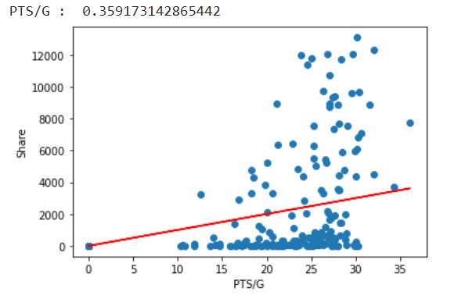
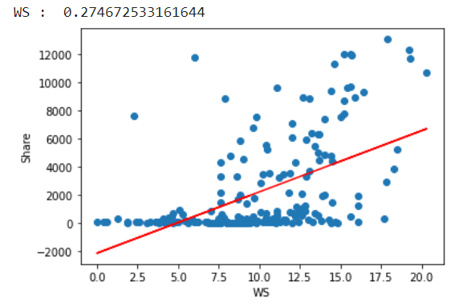
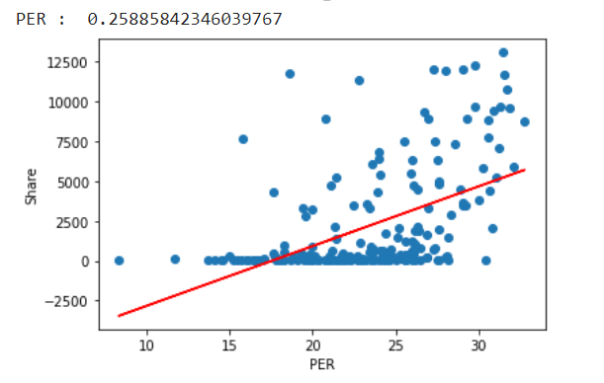
Graphing Features
Which features should I use to train the model?
Plot features against MVP Share attribute (x10)
Print r2 score
Use features with high r2 score, or features that have real-world effect on MVP qualification (games played)

Slide 14
Features Selected
WS - Measure assigned based on offense, defense, and playing time, equivalent to ⅓ of a team win
TS% - Shooting percentage adjusted to 3pter and FT, measures efficiency at shooting
PER - Player’s per minute productivity, accounts for numerous general statistics
USG% - Percentage of team plays a player was involved in when playing
MP/G - Minutes played per game
PTS/G - Points per game
G - Games played
Team Wins - Team wins

Slide 15
Modeling
Which model did I use?

Slide 16
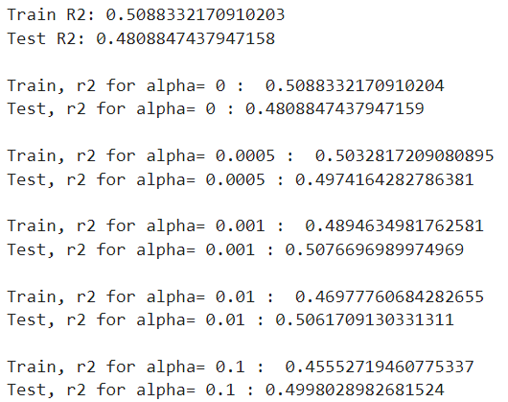
Results
Features used:
WS
TS%
PER
USG%
MP/G
PTS/G
G
Team Wins
Training Split:
70% training
30% testing
Random state = 28

Slide 17

Multiple Linear Regression
What is it?
Models relationship between dependent and independent variables
Assumes all variables are equally important
Why might it be flawed/inaccurate?
Some variables demonstrate a stronger relationship than others, and are thus more important
Overfitting - Complex data causing training data to fit too closely, fails to generalize to new data

Slide 18
Model Analysis
In what ways can my model be improved?

Slide 19
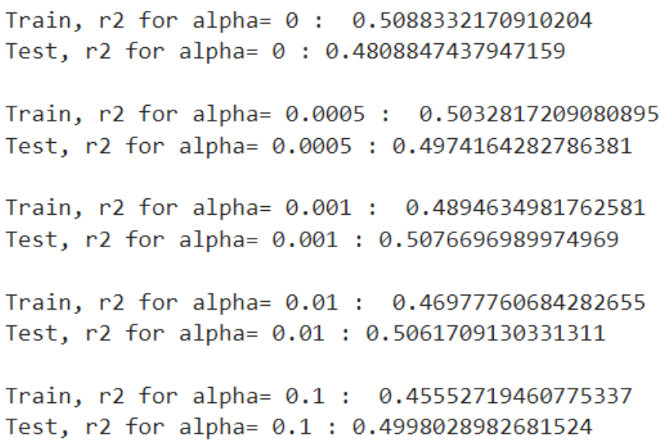
Lasso Regression
What is it?
Form of linear regression
Shrinks regression coefficients based on alpha value
Prevents overfitting by placing less value to certain features
Why is this useful to my project?
Slightly overfit (0.5 > 0.48)
By testing different alpha values, I can find a more balanced model
Alpha = 0.0005

Slide 20
Model Analysis
The MVP process is very subjective and not entirely accurate based on regular season stats
Voter fatigue (getting sick of one dominant player)
Postseason success
Historical significance
Backstory or journey
Shares are not equally/fairly distributed
30-40 Players with MVP-level stats, only 10-15 get nominations
Player Position Bias
Different positions have different criteria for being considered an MVP-caliber player
PG has more assists, lower FG%, C has more reb, higher FG%
Specialty Players
Players with a high stat in a few advanced stat categories, but not in others

Slide 21
Conclusion
Applicability, extended studies?

Slide 22
Conclusion
If the model were made more accurate, predicting the NBA MVP could be useful for:
NBA enthusiasts/betters
NBA players knowing how close they are to the MVP
NBA coaches/GMs knowing how to stop certain players in game

Slide 23
What Could Be Improved?
Using more features
Using features that better predict MVP
Scraping other websites to get more training data (1900’s basketball)
Using different regression models (Support Vector Machines, Ridge Regression, etc)

Slide 24
Reference Section
PER dataset (Kaggle) - https://www.kaggle.com/datasets/justinas/nba-players-data
MVP Share dataset (Basketball Reference) - https://www.basketball-reference.com/awards/awards_2022.html
Basic Statistic dataset (Basketball Reference) - https://www.basketball-reference.com/leagues/NBA_2022_totals.html
Advanced Statistic dataset (Basketball Reference) - https://www.basketball-reference.com/leagues/NBA_2022_advanced.html
Team W/L dataset (Basketball Reference) - https://www.basketball-reference.com/leagues/NBA_2022_standings.html
Colab Notebook - https://colab.research.google.com/drive/1ALlY1yNpyAeQm6pkPnC9wBiaQQ2K03-V#scrollTo=As3vvzjSvMwH

